Slide 1
FHIR Terminology
Lloyd McKenzie
FHIR Developer Days
November 25, 2014

Slide 2
This presentation
Can be downloaded here:
http://www.slideshare.net/DevDays2014
Is licensed for use under the Creative Commons, specifically:
Creative Commons Attribution 3.0 Unported License
(Do with it as you wish – just give credit)

Slide 3

Who am I?
Name: Lloyd McKenzie
Company: Gevity
Background:
One of FHIR’s 3 principle editors
Co-chair FHIR Management Group
Co-chair HL7 Modeling & Methodology
Chair HL7 Canada Architecture & Infrastructure
Heavily involved in HL7 and healthcare exchange for last 15 years (v2, v3, CDA, etc.)

Slide 4
Who are you?
Who is familiar with:
V2
V3
CDA
Background
Technical (e.g. developer, architect)
Clinical
Non-technical (e.g. manager, CEO)

Slide 5
Tutorial Objectives
In next 1.5 hours
How is coded data shared in FHIR?
Understanding bindings and profiling vocabulary
Process to creating and use value sets
Future of FHIR terminology

Slide 6
Sending Coded Data

Slide 7
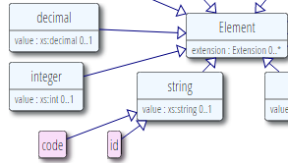
The “code” data type
Just a code
Code system is fixed
Value set is fixed*
Display name is known
Used for “structural” elements
Essential to fundamental interoperability
Reasonable to standardize at the international level
E.g. status, bundle.type, etc.

Slide 8
What if I need a different “code”?
Code data elements aren’t extensible
Can’t send your own custom codes
If coded element is optional
Omit the element and just send an extension
If coded element is minOccurs=1
Choose the code closest matching your need
Send additional semantics as an extension
Consider submitting a change request for inclusion in a future version of FHIR

Slide 9
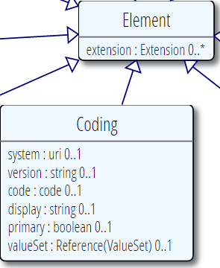
Coding
Code + system
Not often used directly
If you need one coding, you probably need translations and/or original text -> CodeableConcept
Why is everything optional?

Slide 10
URL vs. OID
In v2, you could identify code systems (and identifier systems) in a variety of ways
typically a local string
In v3 you had to use OIDs
E.g. 2.14.1237.937.25.58
In FHIR, we use URLs
E.g. http://myhospital.org/codes/labresults
Can also use urn:oid:2.14.1237.937.25.58
But why would you want to?
Human-readable
Potentially resolvable
No training required

Slide 11
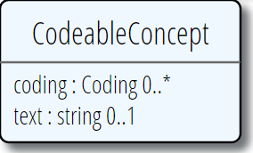
CodeableConcept
All codings are “equal”
One can be “primary”
reflects “originally selected”, not “what my profile wants”
To maximize interoperability, send what codings you know
Text and coding.display are fallbacks for systems that don’t recognize your code
So good practice to include them

Slide 12
What to use in an extension?
Default is CodeableConcept – it’s safest for subsequent migration and interoperability
Use coding only if translations don’t make sense (not just if you don’t currently have need)
Use code if
essential that everyone use the same codes
you can define a set of codes that cover the space

Slide 13
Codes vs. Identifiers
Coding
Identifier
code
system
display (for code), version, primary, valueSet
Represents meaning/concept
Can cover real things such as countries, states
value
system
label (for system), use, period, assigner
Represents “identity”, but can identify a “kind”

Slide 14
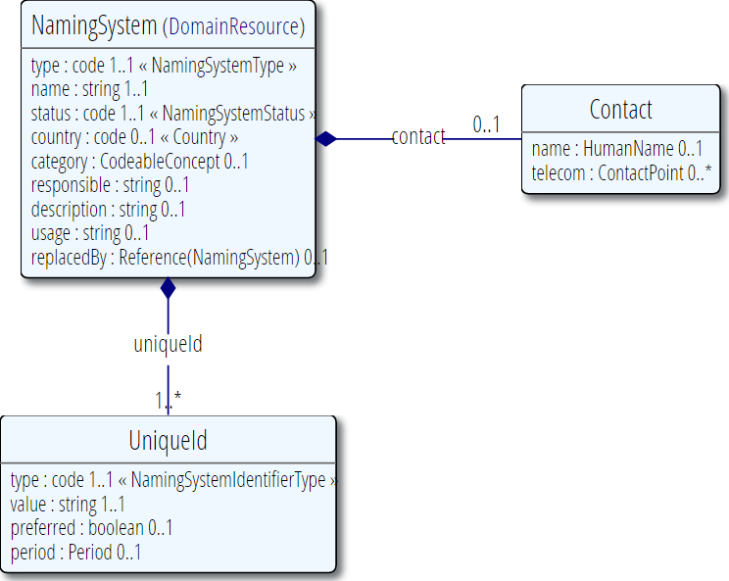
Namespace resource
Defines both code systems and identifier types
Allows mapping between OIDs, URLs, etc.

Slide 15
Bindings

Slide 16
Bindings
Bindings identify what sort of codes are allowed for a given element
Can be:
Value set
Defined set of codes from 1..* code systems
Reference
E.g. Mime types
Description
E.g. Location type codes

Slide 17
Binding Conformance
required: You must use the specified codes
at least for concepts they apply to
preferred: You SHOULD use the specified codes
But if you have a good reason, you can use something else instead
example: These codes just give an idea of what you might use
No expectation (or recommendation) of use

Slide 18
Binding Extensibility
Non-extensible: The set of codes is considered to be complete. Depending on conformance level, you SHALL/SHOULD not use additional codes
Extensible: The set of codes is likely incomplete. You may use additional codes to convey concepts not represented in the bound set of codes

Slide 19
Example
Value set: Red, Blue, Green
Binding | Concept = Navy | Concept = Orange
required, non-extensible | Must use Blue | Not codeable
required, extensible | Must use Blue | Can use Orange
preferred, non-extensible | Should use Blue, can use Navy | Shouldn’t use Orange, but can
preferred, extensible | Should use Blue, can use Navy | Can use Orange
example, extensible | Use whatever you like | Use whatever you like

Slide 20
But those aren’t the terms in the ballot . . .
Resource binding | Binding Conformance | Binding Extensibility
Fixed | required | Non-extensible
Incomplete | preferred | Extensible
Example | example | Extensible

Slide 21
Profiling vocabulary
Extensible -> Non-extensible
Example -> preferred -> required
Exclude codes from parent value set
If parent was extensible, add codes to value set

Slide 22
Value Sets

Slide 23
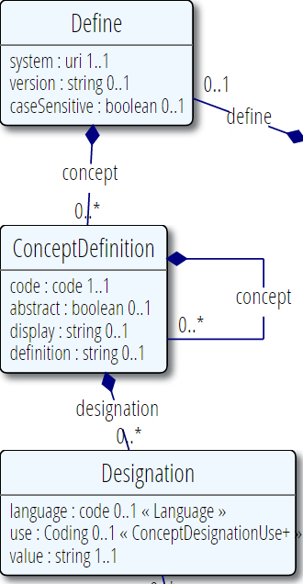
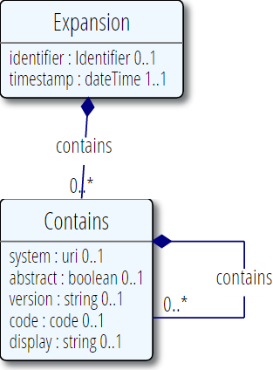
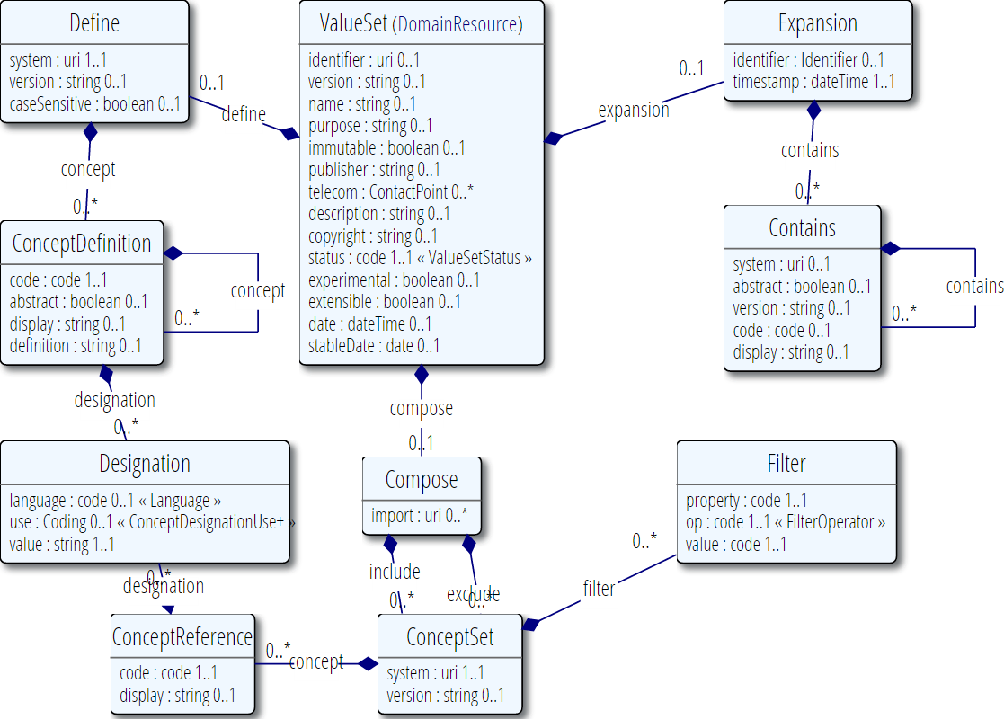
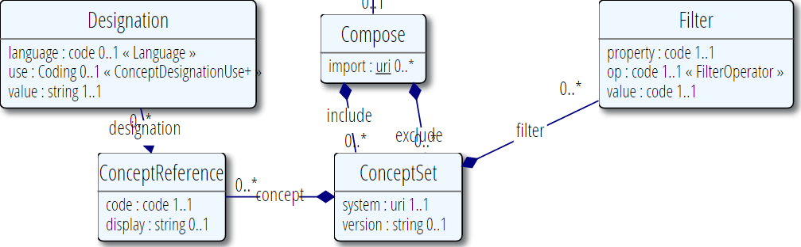
Value Set

Slide 24
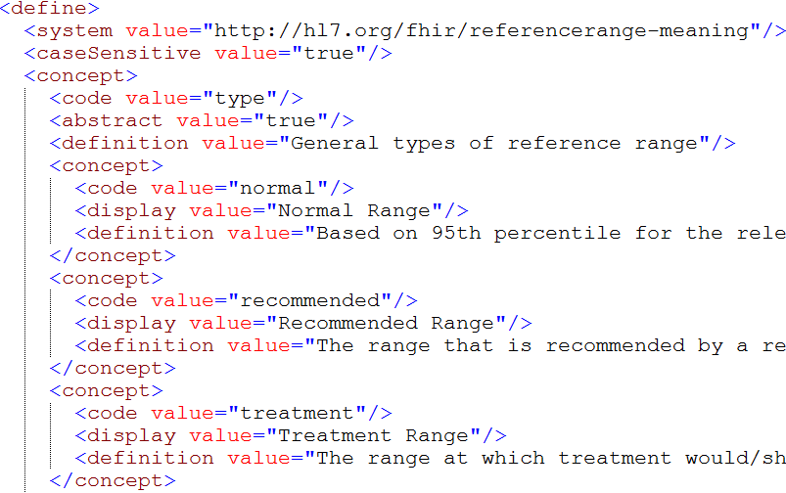
Define example

Slide 25
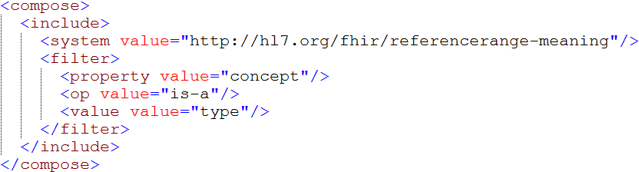
Compose example

Slide 26
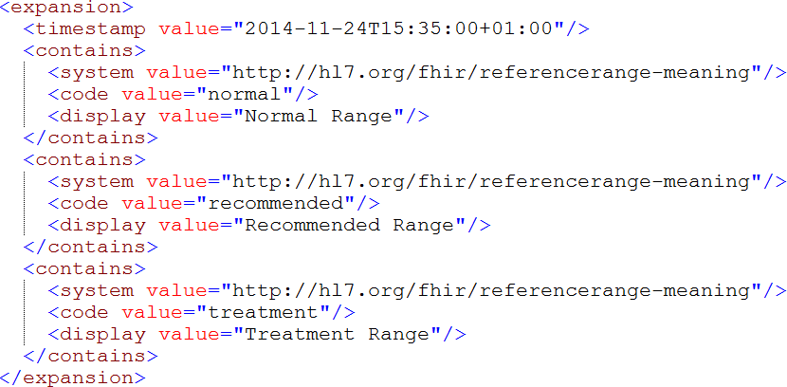
Expansion example

Slide 27
Code system vs. Value set
Code systems define symbols with specific meanings
E.g. LOINC, SNOMED, ICD-x, IETF language codes, local lab result codes, etc.
Value sets define collections of codes for use in a particular context
E.g. Codes for vital signs, codes for procedures
Can come from multiple code systems or a single code system

Slide 28
Search and other operations

Slide 29
Search parameters
Token
Exact match: system|code
gender=http://hl7.org/fhir/v3/AdministrativeGender|F
Code, any system: code
gender=F
Code, no system: |code
gender=|F

Slide 30
Search parameters
Modifiers
Display Coding.name or CodeableConcept.text: text
gender:text=female
Code in value set: in
Gender:in=http%3A%2F%2Fhl7.org%2Ffhir%2FValueSet%2Fsome-genders
Code on in value set: not-in
Gender:not-in=http%3A%2F%2Fhl7.org%2Ffhir%2FValueSet%2Fsome-genders

Slide 31
$expand
Takes in a value set and returns the value set containing the expansion as of “now”
http://....ValueSet/someId$expand
http://...ValueSet$expand?[someURL]
http://...ValueSet (pass ValueSet in body)
Additional parameters
filter: Only include concepts with display name containing string
date: Generate as of specified date

Slide 32
$validate
Takes a code/Coding/CodeableConcept and checks if it’s valid against a value set
Specify value set same as for $expand
Code to validate
code+system, version, display
coding
codeableConcept
date – date to validate as-of
Outputs: true/false
message if not valid, display names if valid

Slide 33
$translate
Uses concept map to translate code
http://...ConceptMap/id$translate
code, Coding or CodeableConcept passed as per: $validate
Output:
True if can be translated
Message if can’t be translated
Translated coding if it can be translated

Slide 34
FHIR Terminology Services
FHIR provides most of what’s needed for a fully functional terminology server
Create, update, retrieve and search code systems, value sets and concept maps
including versions there-of
Determine value set expansions, validate codes and translate concepts
Additional guidance here:
http://hl7-fhir.github.io/terminology-service.html

Slide 35
Semantic Web
Work is underway for a third FHIR syntax – RDF
As well, we’re looking at
Supporting conversion of Profiles to OWL
Expression of mappings in OWL and/or SPARQL
Adding additional semantic layers/mappings to allow support hierarchies (e.g. “order-related”, “medication-related”, etc.)

Slide 36


Questions?
http://hl7.org/fhir lmckenzie@gevity.com

